Slide 1
First-Order Predicate Calculus
Mathematical Logic in Formal Specification
Dr. Abdul Rehman

Slide 2
Agenda: Building Better Systems
Understanding the Need for Logic
Real-world Case Studies (Banking, Lib)
The Grammar of Predicate Calculus
System Rules (Invariants)
Modern Tools & Verification
Quantifiers: All and Some
The Future of Bug-Free Software
Formal Specification Fundamentals

Slide 3

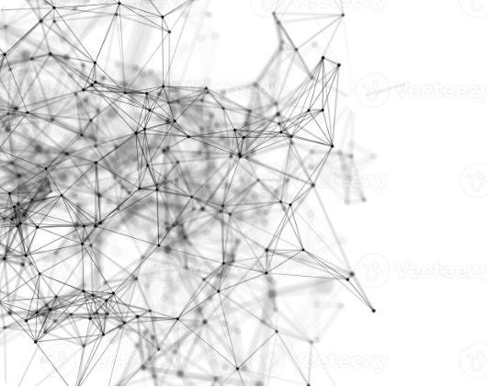
The Problem: Human Language
Human language is messy and vague.
"The system should be fast" means different things to different people.
Ambiguity leads to software bugs.

Slide 4

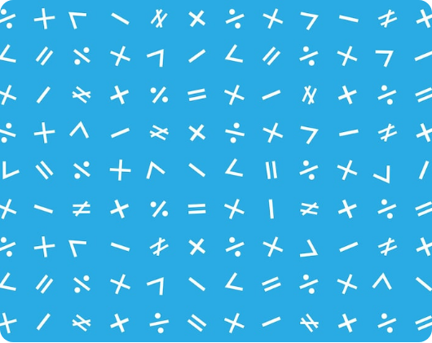
The Solution: Precise Logic
Mathematical logic provides a single truth.
By using symbols, we remove confusion. A computer can read logic without guessing.

Slide 5

What is Predicate Calculus?
It is a mathematical language used to describe objects and the relationships between them.
Think of it as "Grammar for Math" where we can talk about people, accounts, or sensors.

Slide 6


Beyond Basic True/False
Predicate Logic
Simple Logic
"x is a student." (Depends on who x is)
"It is raining." (True or False)
It allows us to talk about who has a certain property.

Slide 7
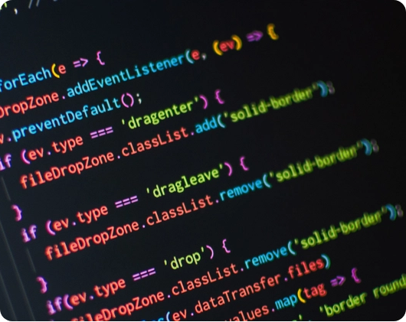
Building Block: Constants
Constants are names for specific things.
John (A specific person)
Account_505 (A specific bank account)
Book_XYZ (A specific book)

Slide 8

Building Block: Variables
Variables (x, y, z) are placeholders for any object in a group.
If x is an Account, then Balance(x) describes the money in any account.
This is how we write rules that apply to millions of users at once.

Slide 9


Building Block: Functions
Functions map one object to another.
They help us navigate the connections between entities in a system.
FatherOf(John)
OwnerOf(Account)

Slide 10
Predicates: The Logic Verbs
A Predicate describes a property or a relation that is either True or False.
They are the foundation of system rules.

Slide 11


The "All" Quantifier (∀)
Universal (∀)
Used to say something is true for everyone.
Example: "All users must have a password."

Slide 12


The "Some" Quantifier (∃)
Existential (∃)
Used to say there is at least one thing.
Example: "There is at least one admin for the server."

Slide 13
Translating: All Students
How we turn English into math:
"Every student loves logic."
Notice the Implication (⇒). It means "If x is a student, then x loves logic."

Slide 14
Translating: Some Bugs
How we describe existence:
"Some bugs are hard to find."
We use AND (∧) because we found at least one thing that is both a bug and hard to find.

Slide 15


Order Matters!
∃y ∀x (Loves(x,y))
∀x ∃y (Loves(x,y))
"There is one person who is loved by everyone."
"Everyone loves someone."
Logic makes these subtle differences perfectly clear.

Slide 16

Part II: Formal Specification
Turning Logic into Engineering Blueprints

Slide 17
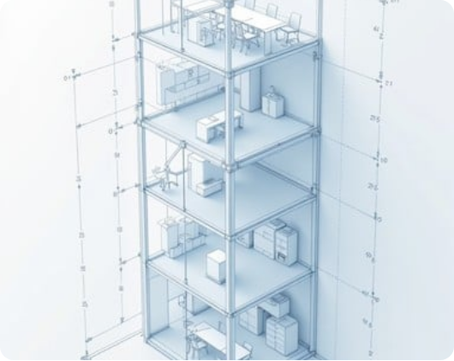
What is a Formal Spec?
It is a mathematical description of what a system should do.
Think of it as a blueprint for a house. You don't start building until the blueprint is perfect.

Slide 18
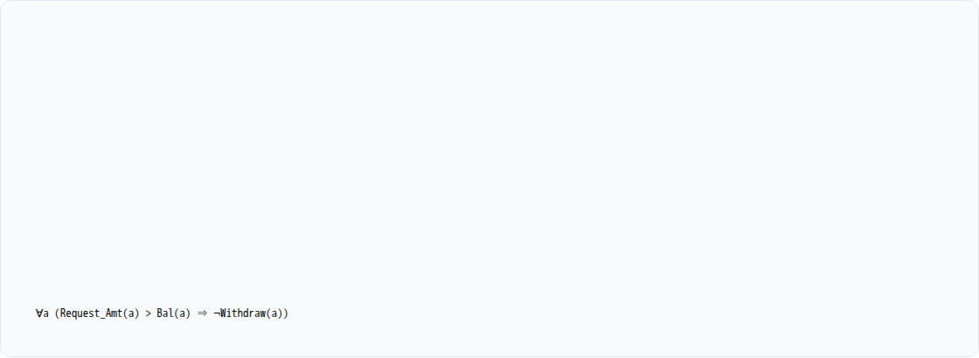
The Goal: Zero Ambiguity
In a formal spec, there is only one interpretation.
English Spec:
"If the user tries to withdraw more than they have, don't let them."
Formal Logic Spec:

Slide 19
Formal vs. Informal
Feature | Informal (English) | Formal (Logic)
Precision | Low (Vague) | Absolute (Exact)
Verification | Manual Review | Mathematical Proof
Consistency | Hard to track | Checked by Software

Slide 20
Pre-Conditions: Entry Rules
Rules that must be true before an operation happens.
User must be logged in.
Input must be a positive number.
The database must be connected.
Logic: Logged_In(u) ∧ Amount > 0

Slide 21
Post-Conditions: Outcomes
Rules that must be true after an operation is finished.
The balance is updated.
A log record is created.
The user receives a confirmation.
Guarantee: New_Bal = Old_Bal - Amount

Slide 22

Invariants: Golden Rules
Rules that never break, no matter what happens in the system.

Slide 23
Case Study: Secure Login
Specifying Access Control:
Pre: User exists and entered password matches.
Operation: Grant Access Token.
Invariant: No user can access data without a valid Token.
Logic ensures there is no "backdoor" into the system.

Slide 24
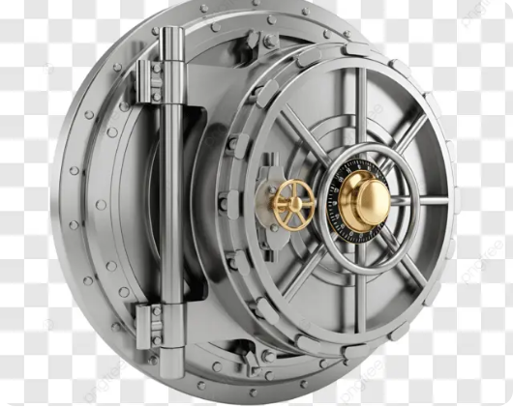
Case Study: Banking Safety
Formal Logic prevents Double Spending.
We prove that money is never created or destroyed, only moved between accounts.

Slide 25
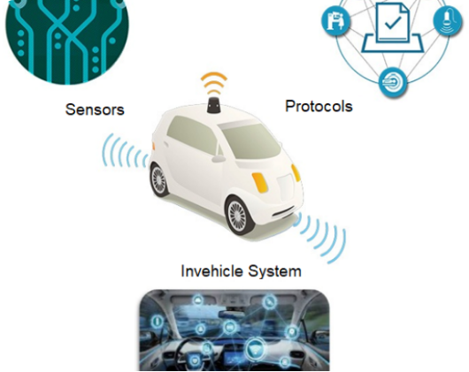
Case Study: Self-Driving Cars
When safety is critical, logic is used to prove that a car will never choose an unsafe action.

Slide 26


Modern Logic Tools
Z Notation
Alloy
A language based on Set Theory and FOPC for large systems.
A tool that finds logic bugs automatically using models.

Slide 27


Proof vs. Testing
Formal Proof
Testing
"I checked every possible situation with math, and it is guaranteed to work."
"I tried 100 things and it didn't break."

Slide 28
Why Logic Saves Money
Fixing a bug in production is 100x more expensive than fixing it on the blueprint.
Formal specs find bugs in the design phase, before a single line of code is written.

Slide 29
The Future: AI & Logic
AI is helping humans write formal specs. In the future, computers might prove their own correctness using Predicate Calculus.
The goal is a world of perfectly reliable technology.

